Slide 1



PROJECT
INSTAHYRE JOB ANALYTICS
PRESENTED BY:
AMARJEET ROY
PRIYA BHARADWAJ
AJAY JOGANI
BHRAT SHARMA

Slide 2


JOB ANALYTICS
ABOUT INSTAHYRE
Cutting-edge Online Job Marketplace
Bridging the Gap Between Job Seekers and Employers
Smart Matching Algorithm for Precise Job-Matching
Extensive Network of High-Quality Candidates
Trusted by Leading Companies and Startups

Slide 3

JOB ANALYTICS
OBJECTIVE AND SCOPE
Build web platform for job-related insights
Skill-based search using web scraping
User-friendly interface
Analyze job market trends
Highlight experience levels, industries, and companies

Slide 4




TOOLS USED
SELENIUM:
PHYTHON:
For Browser interaction and Data extraction
For Data Cleaning and Model building
FLASK:
HTML CSS:
To seamlessly integrate phython functionality into website
For website Development

Slide 5

JOB ANALYTICS
WEB SCRAPPING
Harnessing the power of Python libraries like Selenium, Regex, and Pandas. We conducted web scraping on www.instahyre.com, effectively gathering essential data for further analysis and exploration."
EXTRACTED THREE TABLES:
JOBS
COMPANY
DETAILS

Slide 6
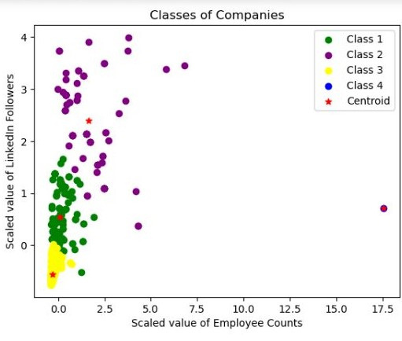
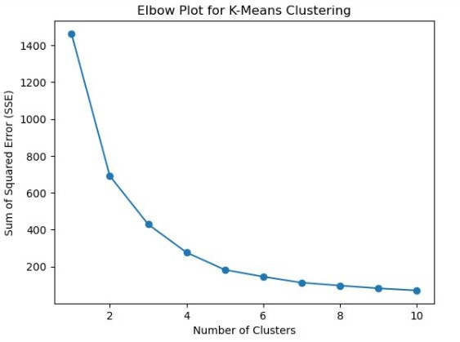
JOB ANALYTICS
Model Building

Slide 7
JOB ANALYTICS
INSIGHTS
Top 10 cities with highest Job opportunities
Top 10 Mentioned Skills
400
125
100
300
75
200
50
25
100
0
Java
AWS
Sales
SQL
0
Python
JavaScript
Node.js
React.js
Business D
HTML
Pune
Noida
Delhi
Bangalore
Mumbai
Gurgaon
Hyderabad
Chennai
Ahmedabad
Work From Home

Slide 8

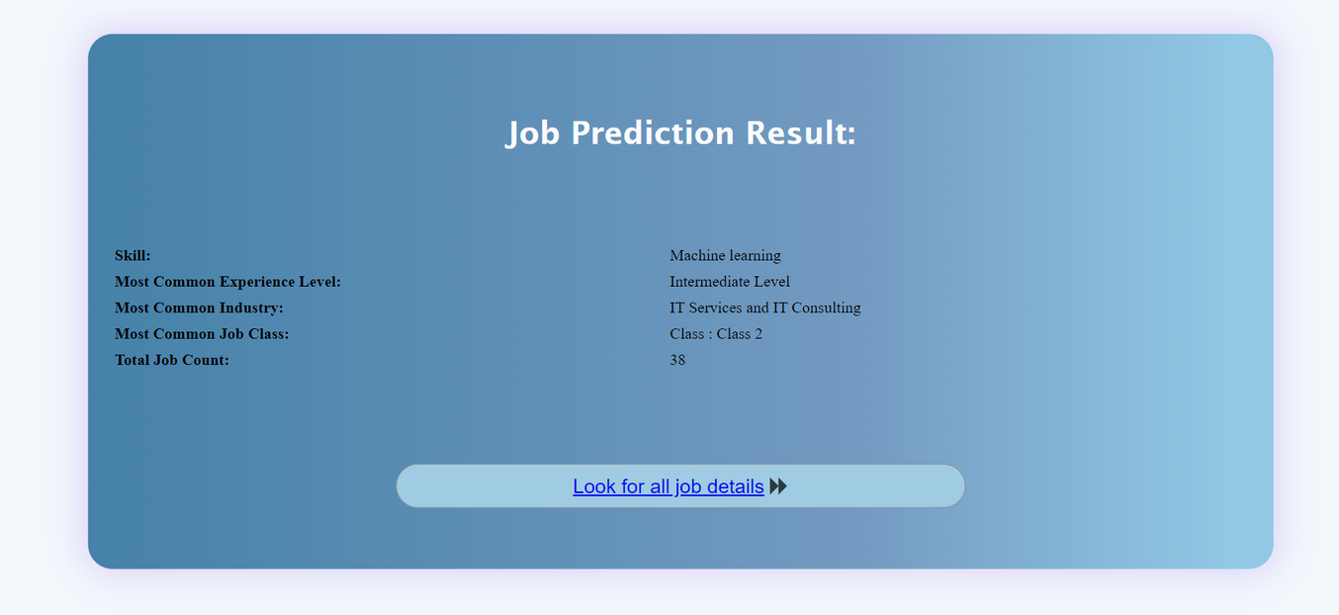
JOB ANALYTICS
WEB DEVELOPMENT
User can Type the skills here
Results user will get as an output

Slide 9
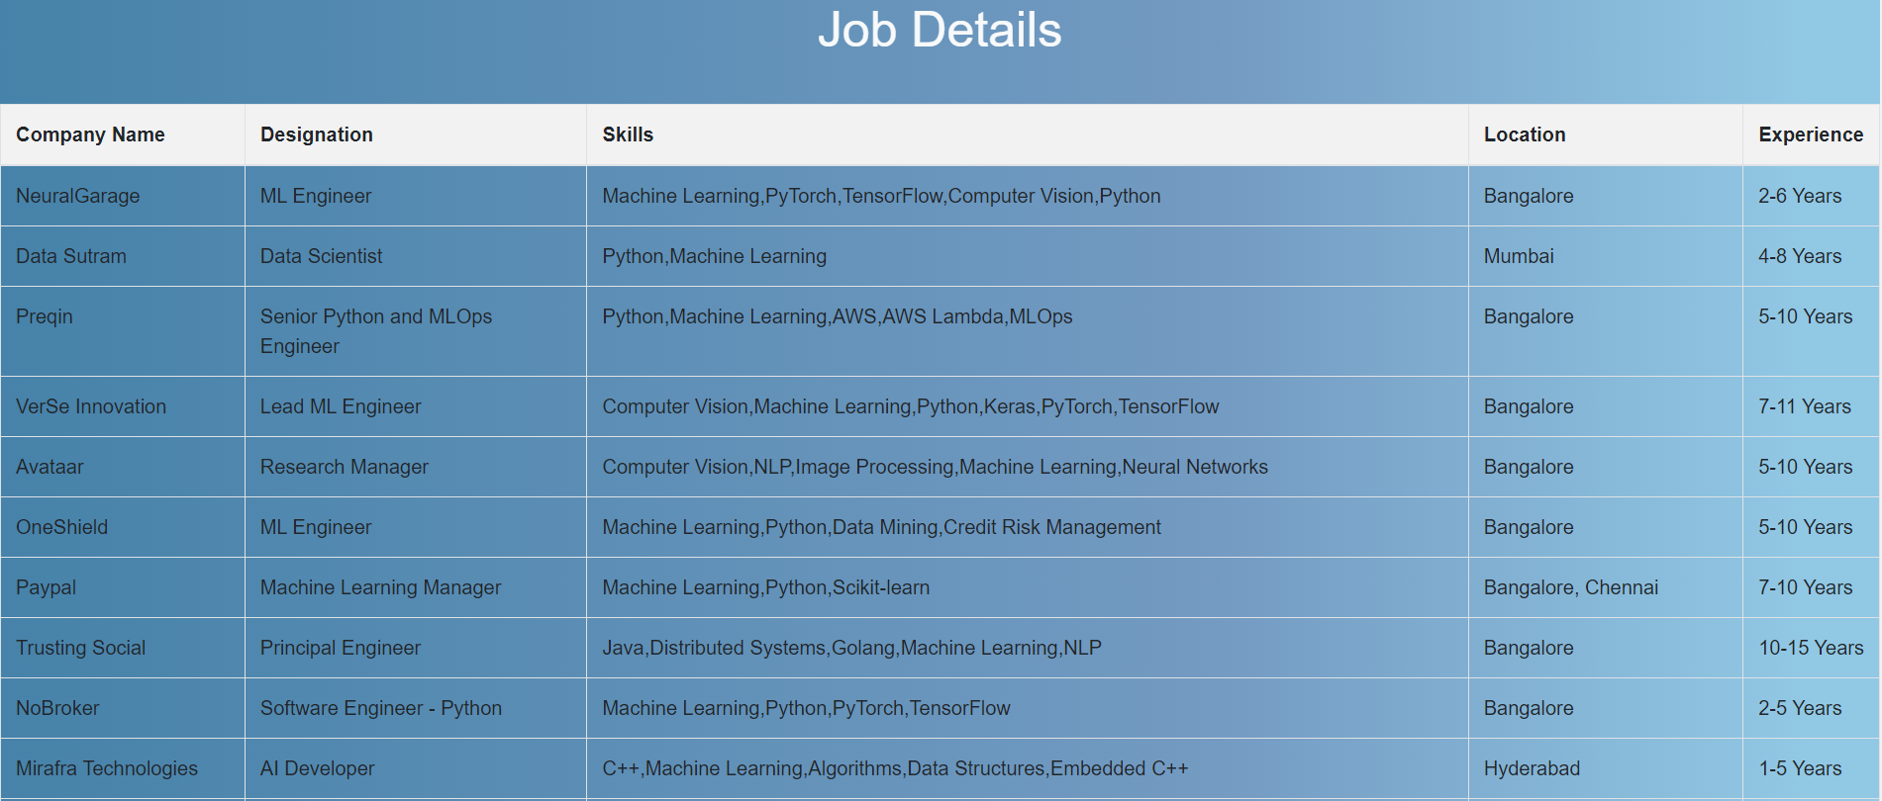
JOB ANALYTICS

Slide 10

JOB ANALYTICS
CHALLENGES FACED
Performing Web Scrapping
Creating web page with the help of HTML/CSS.
Creating backend with Flask and returning output to webpage.
Figuring out how to build model

Slide 11


JOB ANALYTICS
Thank You
For your Attention

